Slide 1
Continence services (DOT WA)
Tabitha Poole (Continence Occupational Therapist)
Notes:
OT persepective

Slide 2
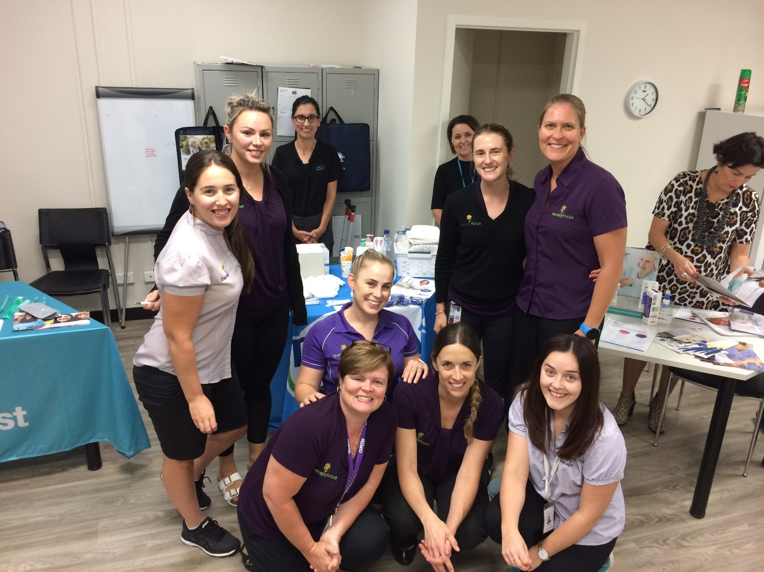
Objectives
Bowel and bladder function of children
When to be concerned/red flags
Overview of Therapy Focus’ continence service
Toilet training best practice
NDIS preparation
Questions
Notes:
Tricky stuff

Slide 3
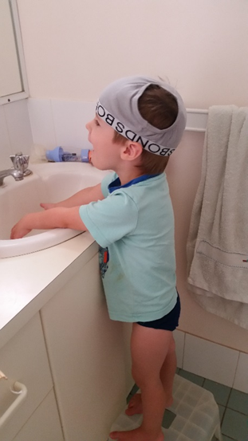
Bladder function - children
Stage 1
Awareness of wet or dirty nappy or clothing
Stage 2
Recognition when doing a ‘wee’ or ‘poo
Stage 3
Indication of the need to wee or poo prior to going (words or a sign)
Stage 4
Holding on for an appropriate place to go to the toilet
Notes:
1-2 years
Develop conscious sensation of bladder
Ability to override reflexes
2 - 3 years: ability to
Void at any bladder volume
Stop urination at any time
Completely empty the bladder
4 years +:
Able to become dry at night
8yrs +:
Bladder can hold 250ml urine
Urinate 4-6 times a day
10yrs:
Adult functional capacity

Slide 4
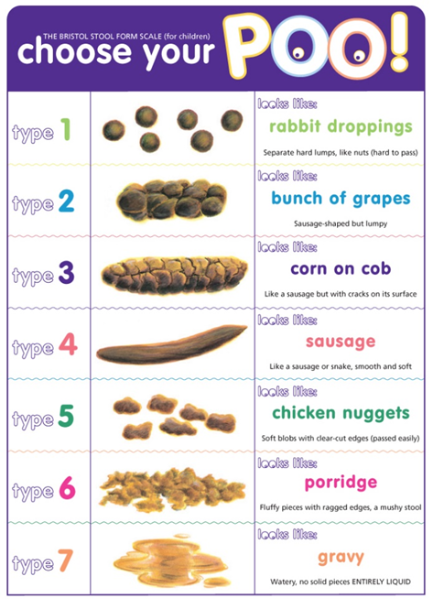

Bowel Function – Optimal
1x every 3 days →3x per day (3yrs+)
Stool type 3-4 Bristol Stool Chart
(if no constipation is evident)
No straining to empty bowel
<3 minutes needed on the toilet
http://www.nursingtimes.net/Journals/1/Files/2011/3/25/Children's%20version%20of%20the%20Bristol%20Stool%20Chart.pdf

Slide 5

Bladder Capacity - Optimal
Age | Expected Bladder Capacity
3 | 120ml
4 | 150ml
5 | 180ml
6 | 210ml
7 | 240ml
8 | 270ml
9 | 300ml
10 | 330ml
12 | 390ml
4-7 voids/day
0-1 voids/overnight
Able to “hold on” for short periods
No leakage
Urgency related to bladder capacity
Expected Bladder Capacity =
(Age + 1) x30ml (Hjalmas, 1992)
Notes:
Baby has no voluntary control over their wee – triggered by cold or touch
As humans get older they develop conscious control and ability to stop the flow of wee
But to have this control = need a fully intact nervous system, and awareness, plus large enough bladder capacity
Original notes**
Baby under non voluntary control – spinal reflexes, reflex voiding, cold or perineum stimulation. (changes of nappy)
Pathways for adult function – synaptic plasticity and frontal lobe inhibition
Continence requires intact nervous system, voluntary control over sphincters, cortical functioning to inhibit voiding and adequate bladder capacity

Slide 6
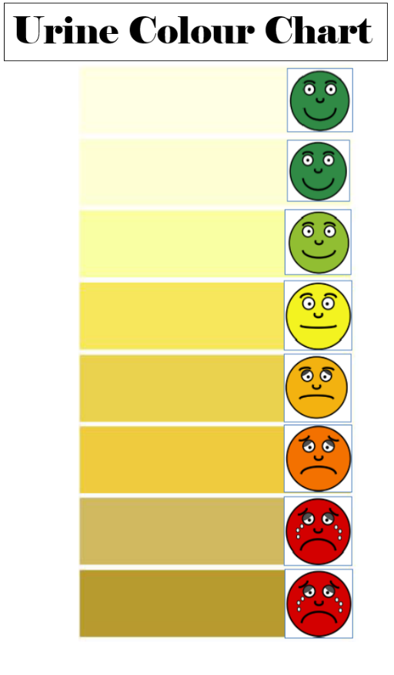
Fluid Intake (rough guide)
1-3yrs: 900mls
4-8yrs: 1000-1200mls
9-12yrs: 1500mls
13+: 1500-2000mls
Notes:
Talk to any dietitian.
Most children should be refilling their drink bottle at least once a day
Many children fluid restrict at school to avoid the toilet
They’ll recommend that instead of coffee you make sure that you’re well hydrated and will feel more energy with this.

Slide 7

Red flags
Sudden onset of accidents/regression
Faecal smearing
Not defecating regularly
Hard, large or obstructive stools
Persistent loose stools
Pain whilst urinating or defecating
Nappy is always wet/urinating more than every hour
Blood in stool or urine
Notes:
“how did that come out of that child?”

Slide 8
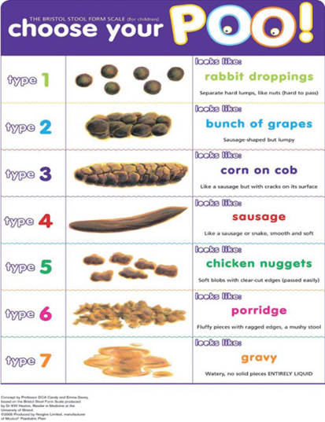
Constipation
Rome IV Criteria for functional constipation
Criteria – 2 or more of the following:
Two or less defecations in toilet per week
At least 1x faecal incontinence per week
History of retentive posturing or stool retention
History of painful or hard motions
Presence of large faecal mass in rectum
History of large diameter stool that obstructs toilet
Criteria – at least once per week for 3months prior to diagnosis

Slide 9
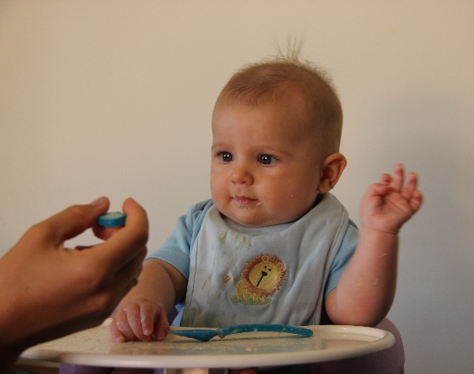
Starting solids and constipation
Change to gut absorption and processing
Increase water
Reduce excessive milk intake (not breastmilk)
Increase soluble fibre
  Fruits/vegetables
  Pureed pear/apple/prune/pumpkin/sweet potato
  Think of the consistency of the food

Slide 10
Prevalence
Autism
  7% urinary problems,
  30% functional constipation.
  higher LUTS – Urgency and postponement,
  bowel control 42.5% ASD v 7.5% TD (Von Gonthard et al, 2015)
Cerebral Palsy 36-73%
Downs syndrome-
  27.3% LUTS, more frequency in males.
  Functional constipation in 50% (Mrad et al, 2008)
Intellectual Disability 23-86%,
  60-65% OAB and Sphincter dyssynergia and reduced bladder capacity (EV Lecke, 2008)
**30% constipation persist into adolescence and adulthood (Proctor &Loader, 2003)

Slide 11
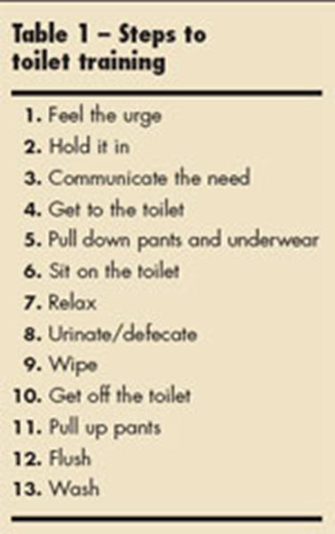
Children with disabilities may take longer
Difficulty recognising sensation of need to go
Difficulty getting to the toilet, removing clothes and sitting
Difficulty communicating need to go and to get assistance
Difficulty learning skill involved
Difficulty with remaining sitting in position for toileting
Difficulty with body awareness and awareness of cleanliness
Lott & Kroeger, 2004

Slide 12

Bladder and Bowel dysfunction
2008)
Daytime wetting
1 in 25 five year olds
Constipation
Approx 10-30% children
Soiling 1 in 30 five yr old
Faecal incontinence
4% 5-6yrs,
1.6% 11-12yrs
Bedwetting (Nocturnal Enuresis)
1 in 10 seven year olds
40 % of children presenting to paediatric urologist have dysfunctional voiding and underlying bowel dysfunction.
(Halachmi et al)
Notes:
Not talking about bed-wetting today as it shouldn’t be an issue at school

Slide 13
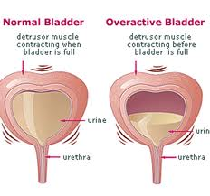
Daytime Wetting (ICCS)
Affects 10% children between 4-6yrs
Functional= empty large volumes of urine infrequently
Urinary tract infections
Constipation
Dysfunctional voiding
Vaginal reflux urine/ labia in obese girls
Phimosis (restrictive foreskin)
Overactive bladder (OAB)
Emotional stress
Developmental issue with some children being inattentive and unaware of their body’s needs
Notes:
Neurogenic bladder- Spina bifida, cerebral palsy.
Withholding leads to constipation
Hiding is often a sign of pain and withholding
Embarrassment can lead to retention: Purposeful can lead to neurological.
Toilet refusal
Considerations for disabilities
Anxiety, communication, dependent on others, cognitive ability, lack of understanding of task

Slide 14

Bowel Dysfunction
Functional constipation – 95 % do not have organic cause
Congenital – anorectal malformation
Neurogenic bowel – Spina bifida, CP MD
Endocrine Disorders – hypothyroid, diabetes
Notes:
Functional – does not have organic cause – 95% - OFTEN see withholding behaviour, hiding, toilet refusal, embarrassment
Constipation can be 2nd to organic cause in 5% cases (minority)
These include:
Congenital abnormalities – Anorectal malformations
Neurogenic causes – spina bifida, CP, Muscular dystrophy
Endocrine – hypothyroid, diabetes
Cow’s milk intolerence

Slide 15
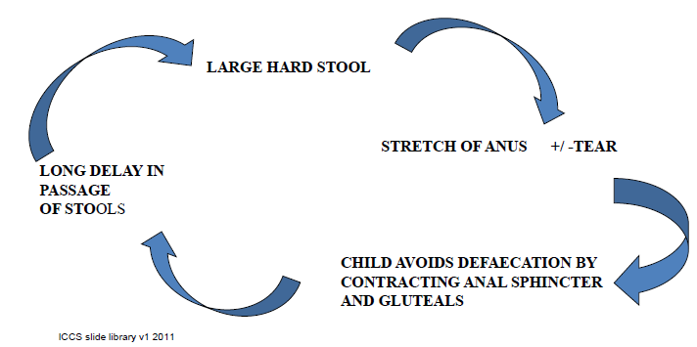
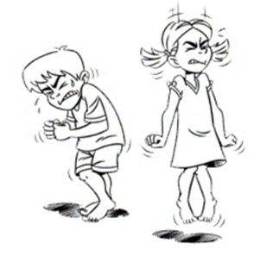
Constipation Cycle
Rectal distension ➔ rectal hyposensitivity
Faecal impaction ➔ overflow
Notes:
Withholding
Dislikes sensation passing stool
Not sitting long enough
Insufficient fluid intake
Restrictive eating practices
Environment
Change in routine
Low muscle tone

Slide 16
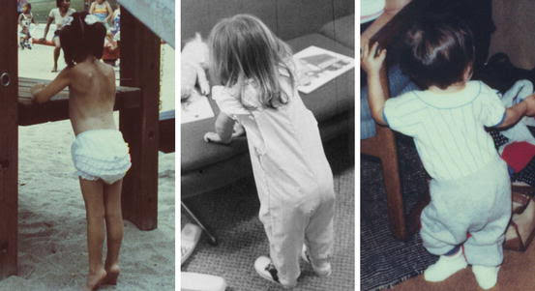
Notes:
Withholding
Dislikes sensation passing stool
Not sitting long enough
Insufficient fluid intake
Restrictive eating practices
Environment
Change in routine
Low muscle tone

Slide 17
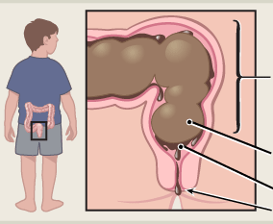
Faecal Incontinence
Passage of faeces in inappropriate place in a child 4+ (ICCS)
90% is due to constipation and impaction
Infection
Food intolerance
Overstretched Rectum
Hard Poo
Liquid Poo
Anus
Notes:
Withholding
Dislikes sensation passing stool
Not sitting long enough
Insufficient fluid intake
Restrictive eating practices
Environment
Change in routine
Low muscle tone

Slide 18
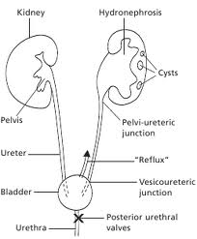
Constipation and painful poos can lead to with-holding for bladder and bowels
Purposeful holding can lead to neurological and physical concerns.
  Overstretched bladder walls
  Hydronephrosis
Notes:
Withholding
Dislikes sensation passing stool
Not sitting long enough
Insufficient fluid intake
Restrictive eating practices
Environment
Change in routine
Low muscle tone

Slide 19
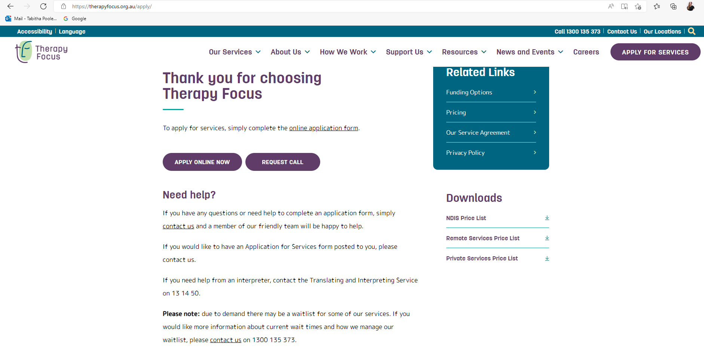
What to do?
Refer to continence services
Google – “therapy focus apply”

Slide 20
Other services/supports
Ngala
Pelvic health physio
GP
Paediatrician
Public and private Gastroenterology/Urology/Endocrinology
PCH continence team
Catheter gap funding and support (Coloplast, Hollister, Convatec)
Independence Australia
Surgical House
Night ‘n’ Day
Psychologist
OT
Social work

Slide 21
Overview of Therapy Focus’ continence service
Multidisciplinary team
State-wide, community-based service
Comprehensive assessment of condition
Management options for individuals experiencing incontinence and bladder and bowel health issues
Advice on continence, bladder and bowel health and toilet training, continence aids and subsidy schemes
Information/education for key stakeholders

Slide 22
Continence clinics and clinicians
Osborne Park – Tabitha (Occupational Therapist) and Odette (Coordinator/Physiotherapist)
Joondalup – Muirna (Physiotherapist) and Selina (Nurse)
Ellenbrook – Michelle (Physiotherapist)
Bayswater – Mel (Therapy Assistant) and Ann-Marie (Nurse)
Cockburn – Andrea (Nurse)
Kwinana – Andrea (Nurse) and Tina (Nurse)
Mandurah – Tina (Nurse)
Margaret River – Rebecca (Physiotherapist)
Maddington – Nicole (Physiotherapist) and Claire (Physiotherapist)
Bentley – Natasa (Physiotherapist)
Bunbury – Sharon (Physiotherapist)
Armadale – Alexis (Physiotherapist)
Mirrabooka – Karina (Nurse)
Notes:
Walitlist times are dependent on clinic.
If client is willing to travel for services – put this on the application form
Share and cross-refer clients, consult with other disciplines within and outside of continence (billable)

Slide 23
Helpline
  continence@therapyfocus.org.au
  Until EOFY!
  1300 135 373
Notes:
We may forward your query to admin team, unless it is a specific, clinical enquiry

Slide 24
Eligibility
-0-65 years of age
-Continence issue
-NDIS funding
-Private services
-Helpline (until EOFY 21/22)

Slide 25
Continence assessment
  Comprehensive initial assessment;
Initial assessment
Clinical assessment
Ongoing assessment during intervention period
  Based on individual client need;
Home visit
School visit
Community visits

Slide 26
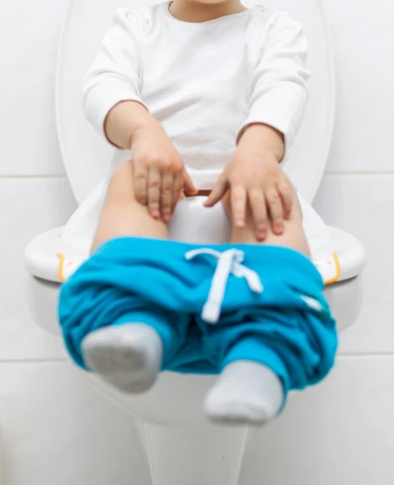
Initial Assessment
Initial meeting with family
Client present if appropriate
Continence and past medical history
Current bladder/bowel health and issues
Current functional ability
Interests and social circumstances
Family toileting goal discussed
Notes:
Why client is often not there. Differentiate between disability v. neurotypical
Individualised assessment
Initial – 1.5hrs via phone or video plus follow up email with bowel/bladder diaries and any other information needed (story)

Slide 27
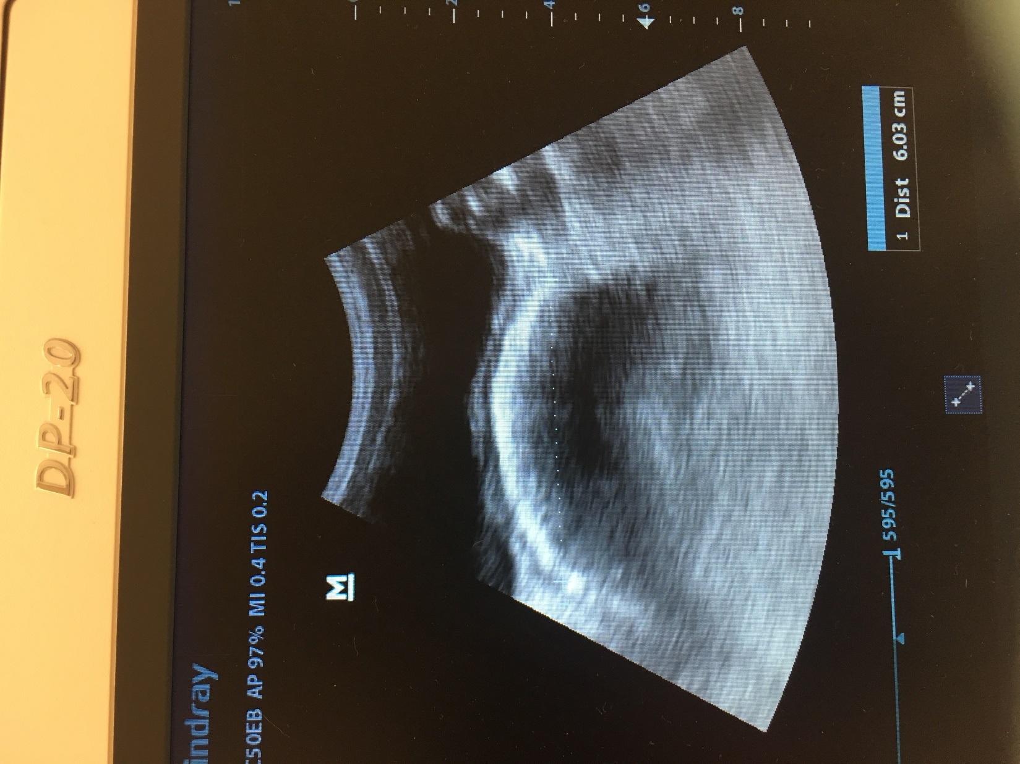
Clinical Assessment
Client attends appointment
Review bladder and bowel charts
Observation of client sitting on toilet
Trans-abdominal real time ultrasound (RTUS)
Uroflometry
Urinalysis
Notes:
Tabitha
-Wide range of clinical assessments combined with observation to increase validity
-Not all clinical assessments completed due to a range of client factors – behaviour, sensory preferences, communication difficulties
Clinic – 1 hr in clinic
-Real time ultrasound
-Pre and post void residual
GP/Urologist/gastro liaison – 30 minutes
Rectal crescent measurement
Pre void volume and post void residual
Uroflowmetry and Urinalysis

Slide 28
Uroflowmetry
Notes:
Stoccato flow which may indicate pelvic floor muscle dyssinergia

Slide 29
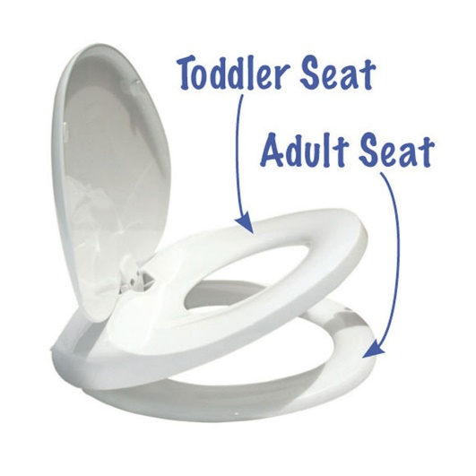
Home Visit
Environmental assessment
Observational assessment of family dynamic
Current toileting routine in home
Task analysis
Posture on toilet
Behaviour around toilet
Sensory preferences
Interoception
Repeat aspects of clinical assessment if appropriate
Notes:
-Not all clients will need/want home visits – this is based on clinical need and availability
-Bowel diaries
-Intervention at this time – take photos for stories, play with dolls, desensitisation
Wiping/hand washing/

Slide 30
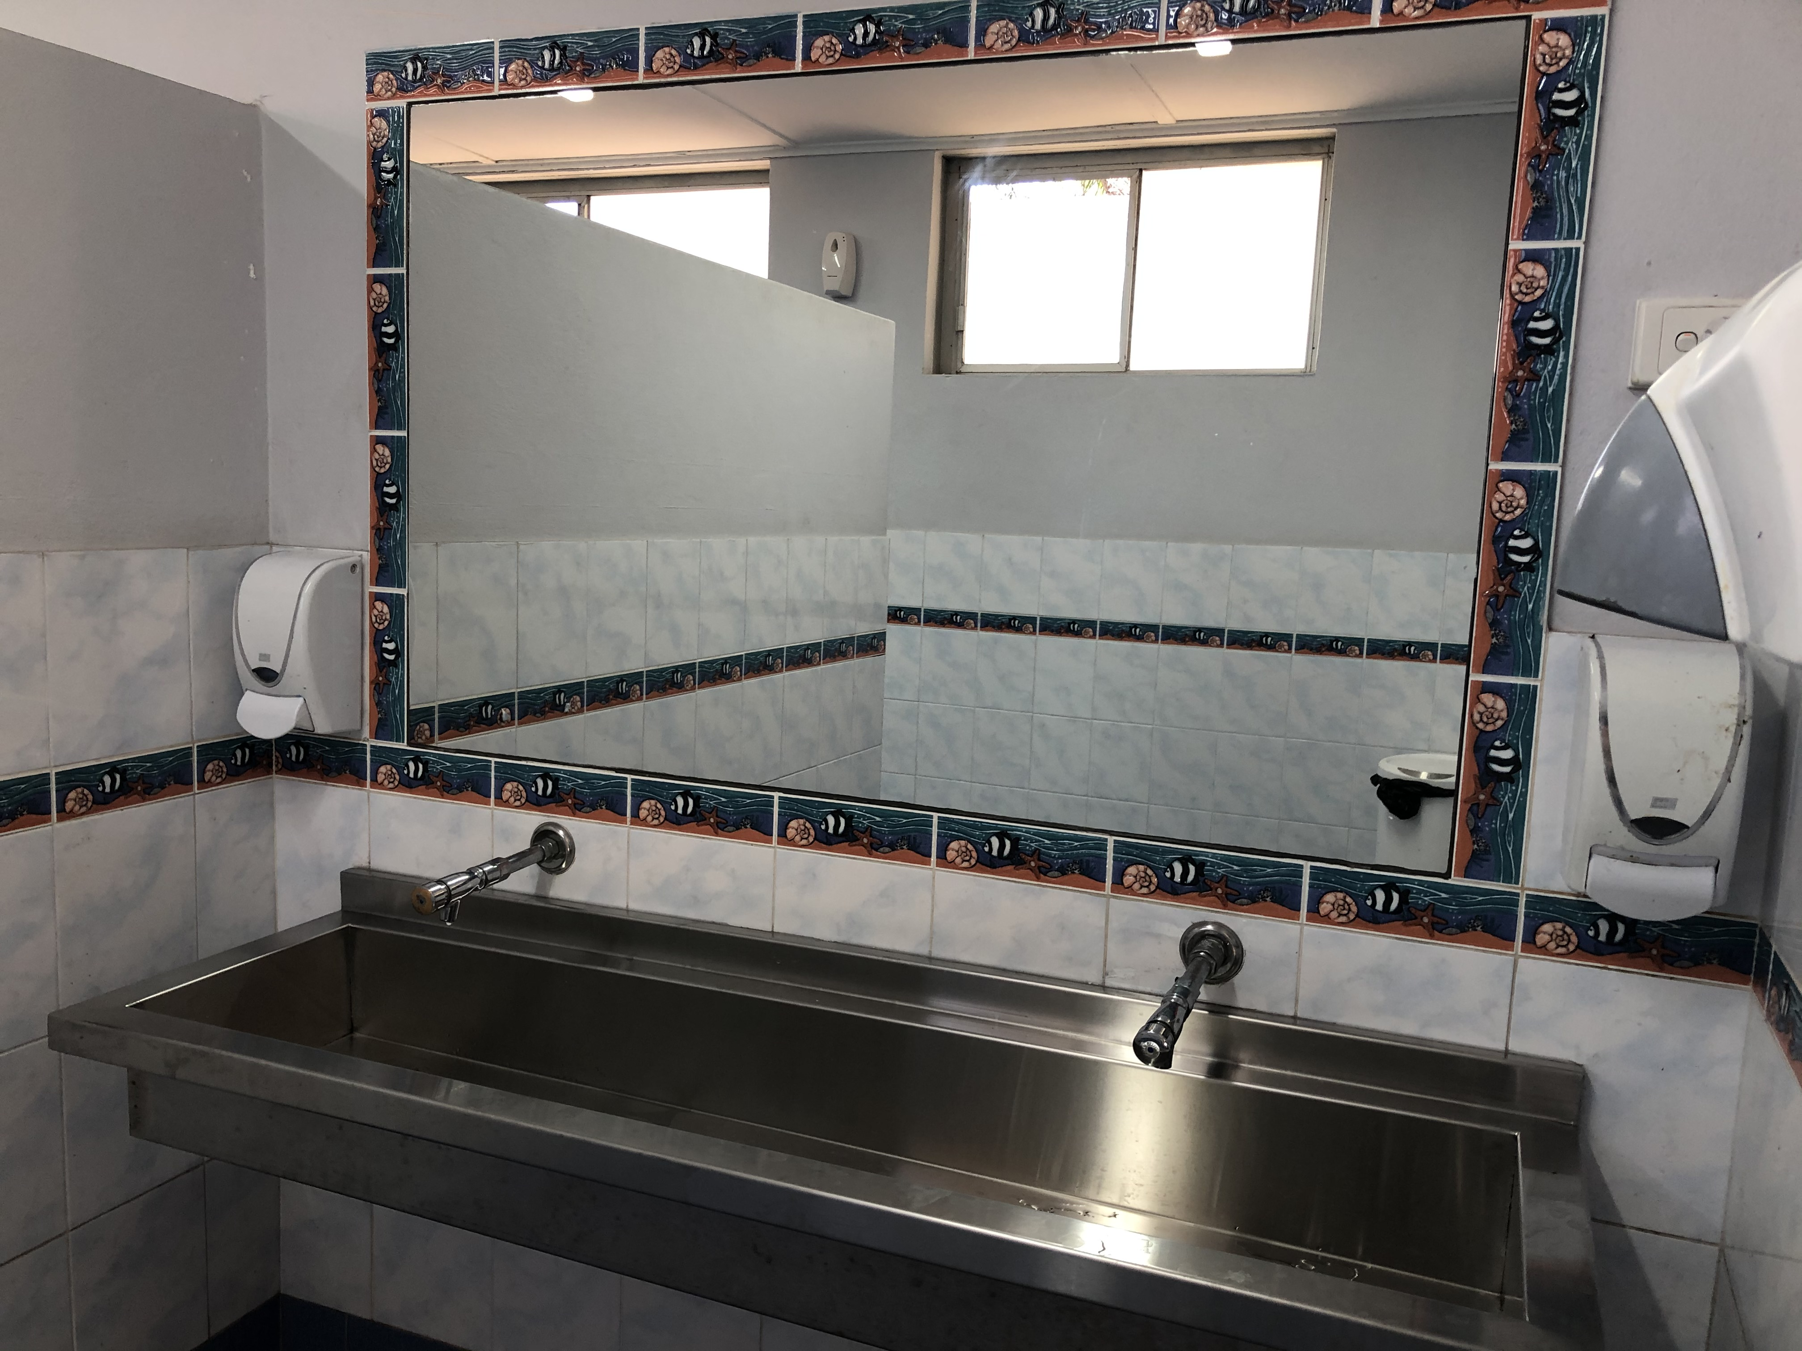
School Visit
School toileting environment
Meet Teachers and Education Assistants
Current toileting routine at school
Eating and drinking habits at school
Consistent plan
Whole class approach
Notes:
Tabitha – 5 minutes
-If client is not attending school, can attend day care
-Success due to structured environment and number of staff to implement programme this often has positive flow on effect to home
-Often phone call done prior to going to school

Slide 31
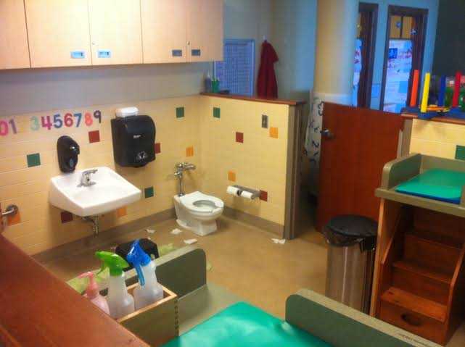
Onset ➔Starting Day-care or School
Different environment
Reduced fluid intake
Sensory overload
Play is too exciting to stop and go to the toilet
Dislike of toilets can alter toilet training if already occurring at home
Restricted time to use the toilet or reduced privacy and group toileting
Notes:
Mum/Dad/carer is no longer prompting them
Reduced access to water bottle
Noises, sounds people ++
New relationships/rules
especially toilet/bathroom

Slide 32
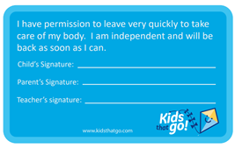
Ideal school/day-care Scenario
  Be able to use the toilet whenever they need to – no restriction
  Urinate 2-4 times daily
  Pass a bowel motion if and when they need to
  Have sufficient fluid access and intake over school day
  Be able to achieve optimal toileting position

Slide 33
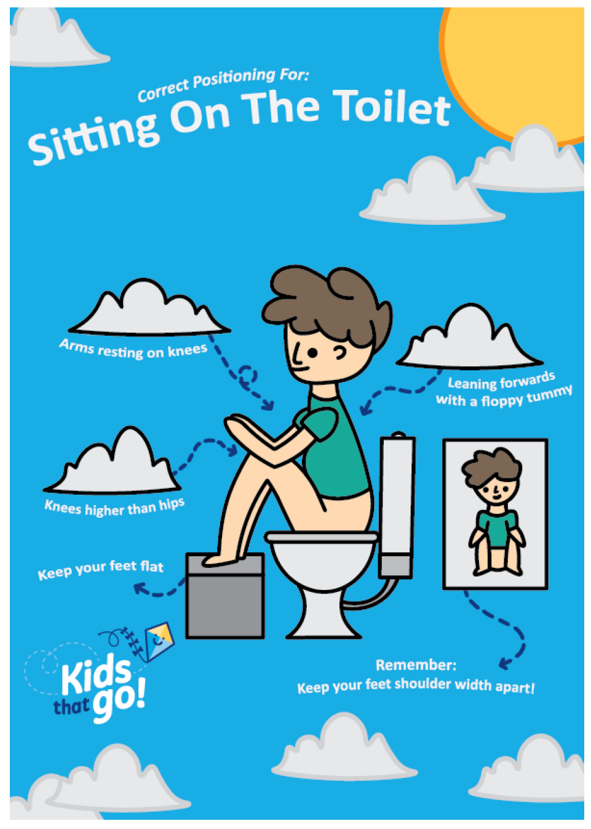
School & Day-care Strategies
Staff to raise concerns with parents immediately
Sequencing charts in all early childhood toilets
Equipment for optimal position
Whole class approach to drinking and toileting
Individual approach where required
Normalise talk about bladder and bowel function
  Strategies for children to ask without words
  Avoid negativity and shaming

Slide 34
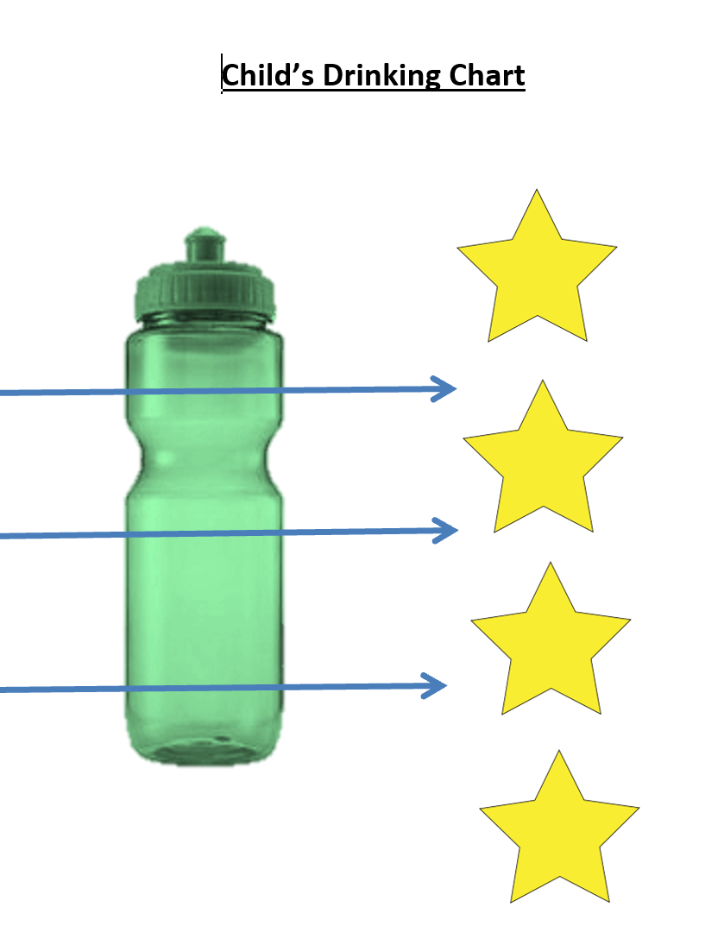
Crunch and Sip/ Recess
Lunch
Afternoon break

Slide 35

Intervention
Individual goals and intervention plans
Toileting environment and equipment
Prescription of continence products
Mat and alarm program for nocturnal enuresis
Desensitisation plans
Work on body sensation/interoception
Timed toileting routines
Fluid intake plan
Creation of resources
Therapy Assistant involvement
Defecation dynamics
Pelvic floor intervention/biofeedback
Notes:
Catheters, peristeen, uridomes, pads, reusable products

Slide 36
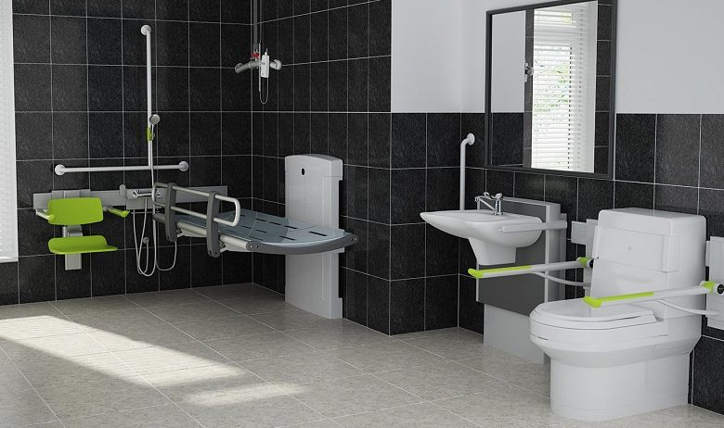
Intervention outside of continence
Behaviour support
Psychology and counselling
Dietitian consult/intervention
Mealtime management
Speech pathology
Home modifications
Notes:
Service delivery
MHEALS
Communication systems, oral-motor skills
Home modifications

Slide 37
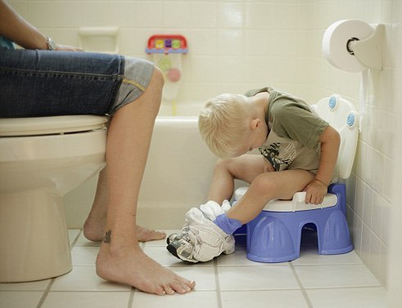
What does it mean to be “toilet trained”
A child is completely toilet trained when he or she no longer requires prompting or support from parents or carers.
Rogers 2013
Notes:
no longer requires help or supervision to use the toilet or potty
aware of the need to go
can remain clean and dry in between times
Timed toileting – functional?

Slide 38
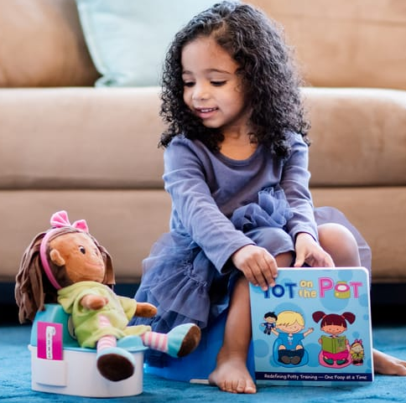
Toilet training – Child
Does your child:
show interest in using the toilet?
like to imitate behaviour?
indicate when they have a dirty/wet nappy?
wake dry after a day sleep?
follow brief instructions?
stay dry for 2hrs or more at a time?
respond well to praise and rewards?
Even if these are not present, you can establish a toileting routine!!!

Slide 39
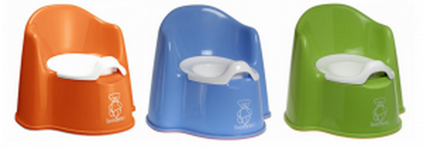
Toilet training – Parent
Do you have:
Time to spend with your child?
A positive attitude?
Patience?
Support?
Realistic expectations?
What pre-conceived toilet ideas do you bring to toilet training/toileting your child?
What toileting habits do you model to your child?
Notes:
-covid toilet training – just tell everyone you’re sick a
When it is an easy time for ALL
Warm weather for no nappy time
Avoid times of change (house move or baby)
Try to start when routine consistent for a few consecutive days
Have all equipment prepared before you start:
underwear,
rewards,
toilet step and seat,
communication aids
nd stay home and toilet train!

Slide 40
Toilet training success
Child
Environment
Parent

Slide 41
Toilet training success
Person
Environment
Occupation

Slide 42
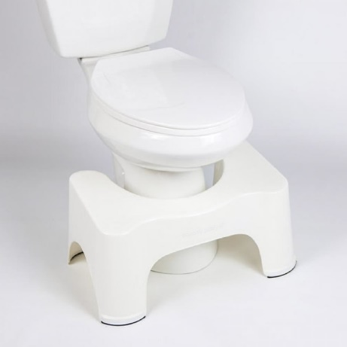
Toilet training – Environment
Is the toilet accessible?
Potty/toilet seat/toilet
Toilet position
Height
Is clothing hard to remove?
  Loose clothing or elastic waisted rather than buttons and zips
Nappies/underwear/underwear with plastic cover
Does anything seem to make your child uncomfortable?
  Fan noise/flush noise/texture toilet paper/smell
  Decorate and make fun!
Notes:
Potty – ok
decorations

Slide 43
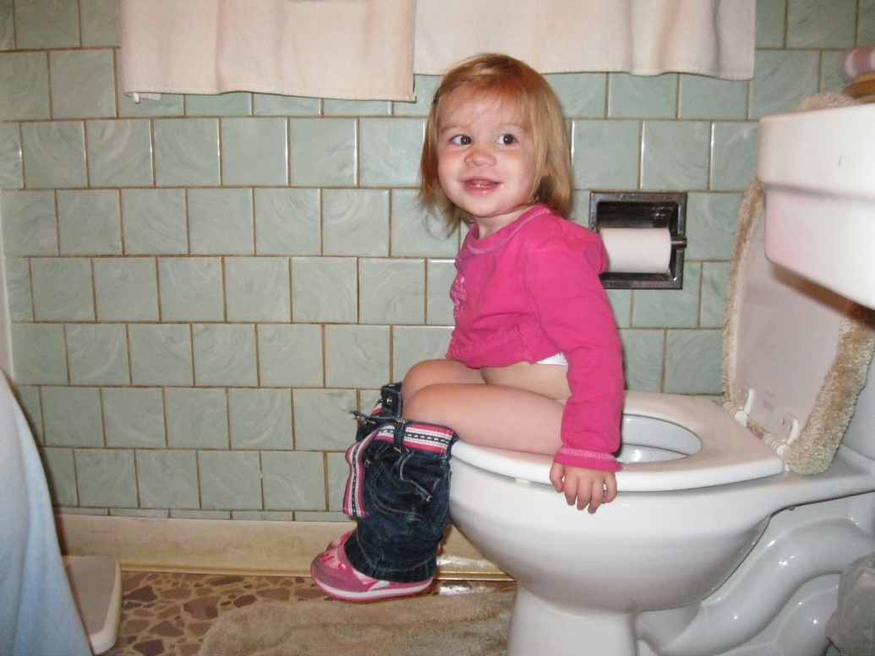
Optimal toilet position?

Slide 44
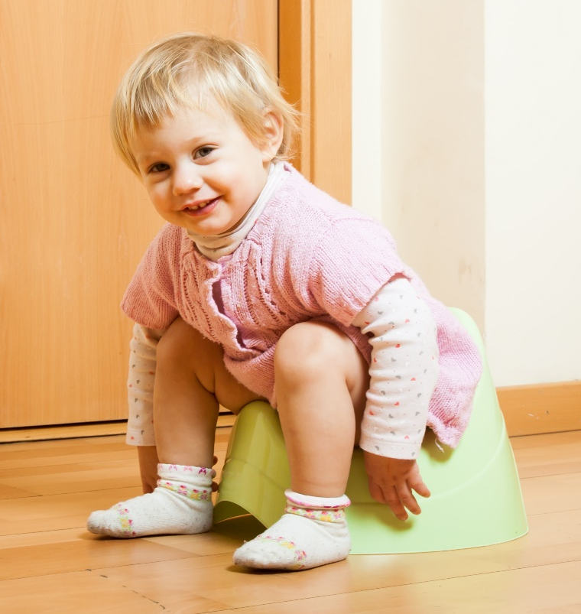
Optimal toilet position
Thighs well supported
Knees higher than hips
Feet wide apart
Remove underwear or nappy from around ankles
Leaning forward with a straight back
Relaxed tummy
No pushing or straining!!
Deep breathing or blowing

Slide 45
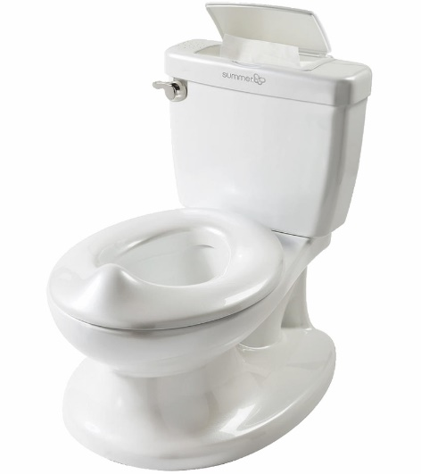
Equipment to facilitate position
Adult/child seat toilet-potty
Toilet step stool
Notes:
Bunnings, kmart

Slide 46
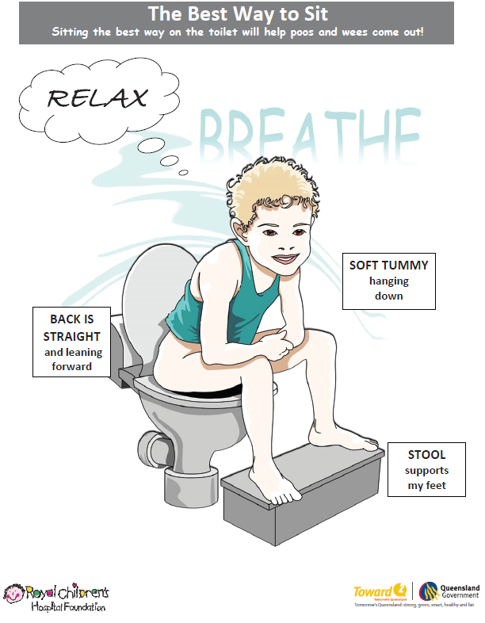
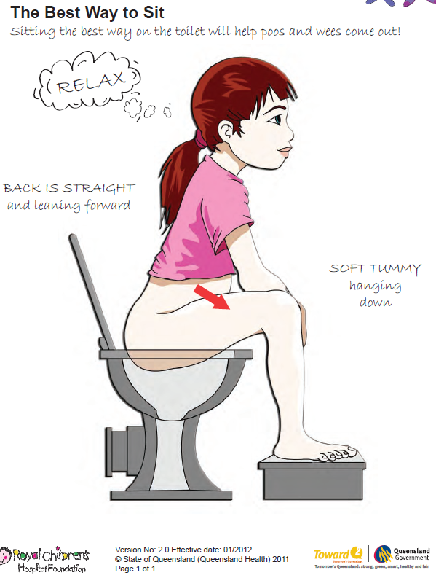
Notes:
Thighs well supported
Knees higher than hips
Feet wide apart
Remove underwear or nappy from around ankles
Leaning forward with a straight back
Relaxed tummy
No pushing or straining!!
Squatty potty video – how a unicorn changed the way I pooped!

Slide 47

Notes:
Break- questions?

Slide 48
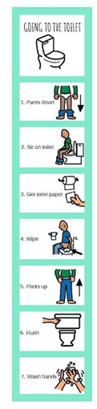
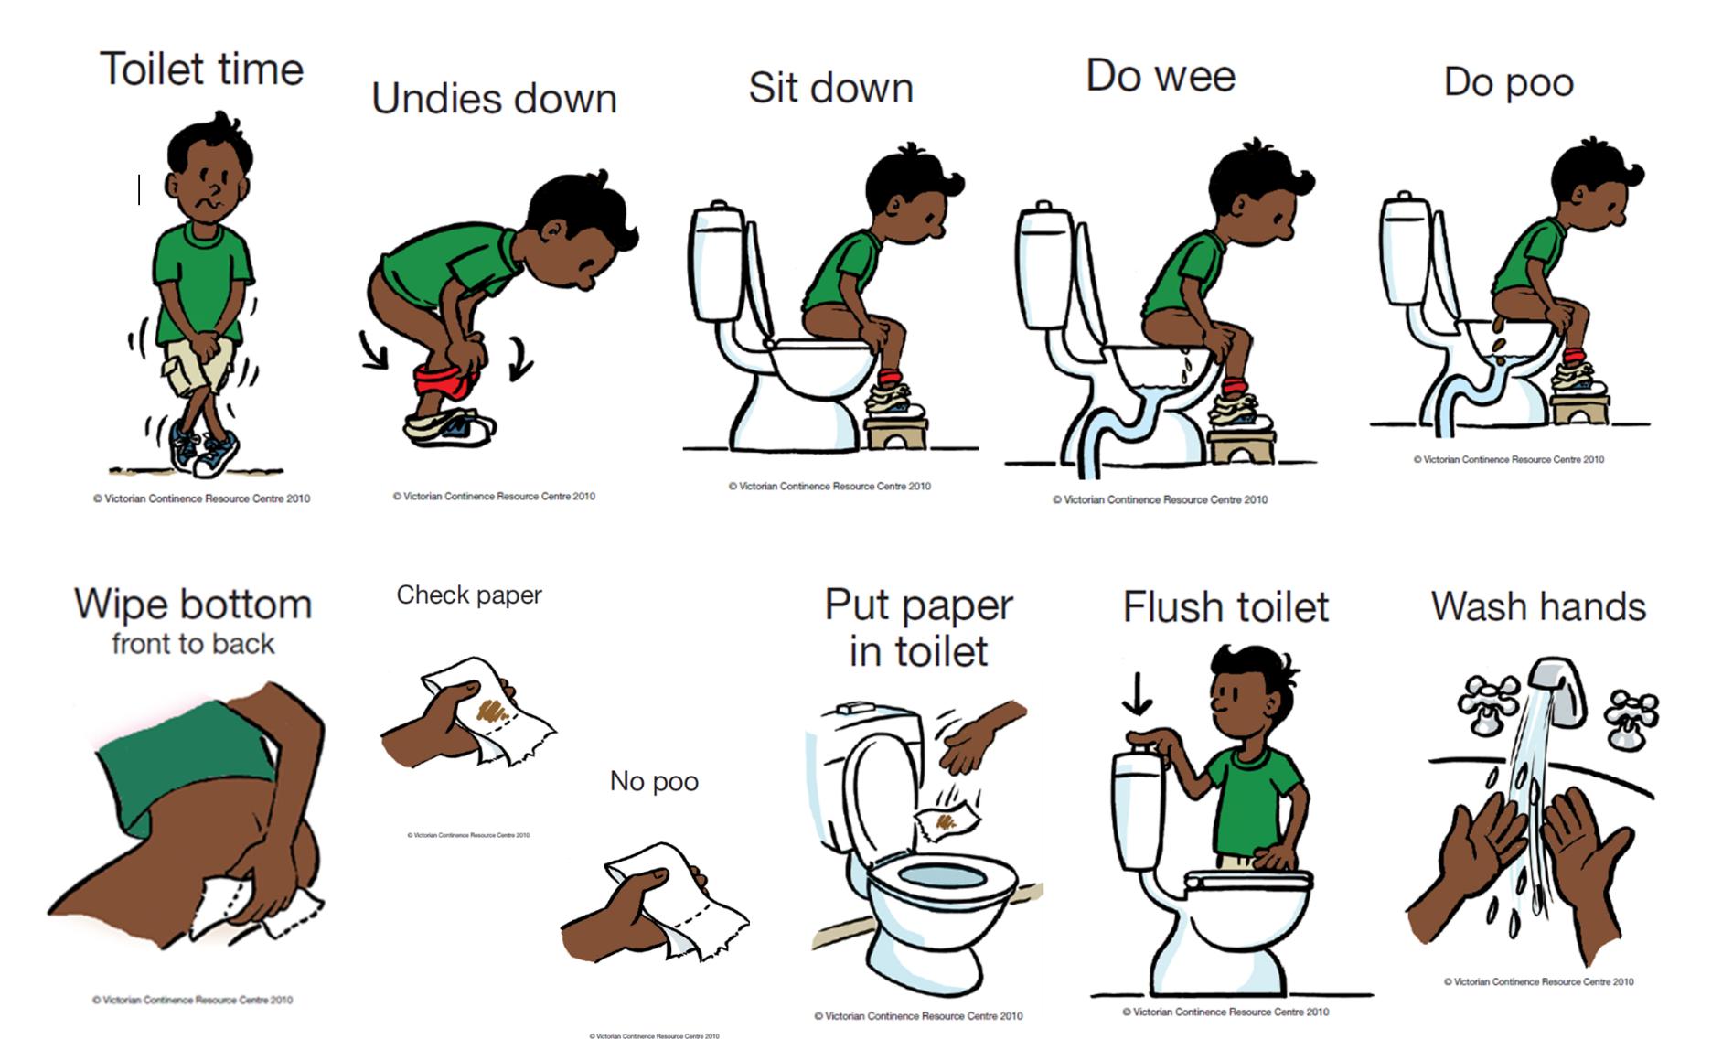
Occupation

Slide 49
Language (keep it factual and positive)
  “I see you’ve done a poo – let’s go clean you up”
  “Everybody poos – even Mummy and Daddy”
  “Wee and poo are the leftover parts from food and drink our body doesn’t need. Wee and poo go in the toilet”
“Toilet time” vs “Would you like to go to the toilet?”
Describe what you can see, smell and hear “ I can see that you are puffing your cheeks out and standing like you want to push a poo out”
Notes:
-model good toileting behaviour – open door policy

Slide 50
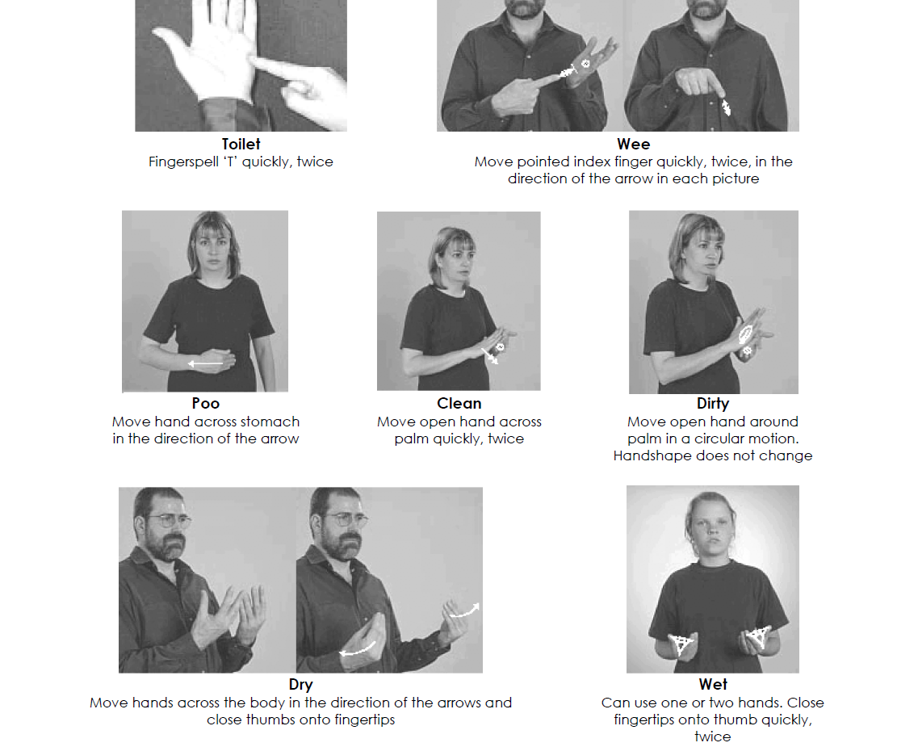
Communication Approach
PECS cards
Visual cards
Key word sign
Visual schedule
Notes:
Visual exchange communication cards

Slide 51

Toilet training
  Underwear
    Effective both positive and negative self reinforcement
    Child often enjoys choosing
    Do you return to nappies once in underwear?
  Child initiated
    Assist them when they indicate they need to go
  Wait and catch
    Time toilet visits with times of day they often void
  Timed sitting
    Fluid load, then observe time between drink and urination
    Increase duration between ‘sits’ as training progresses
    Variable effect – can limit self awareness

Slide 52

Toilet training
Not one “right” way!
Variations in training methods recommended for children with special needs
Assess the family situation
What things do you need to put in place to enable success for everyone involved?
Ensure optimal toilet position
Reward the process initially, focus on the outcome later
Natural consequences (if any)
Stay objective
Make goals clear for everyone

Slide 53

Rewards
Reward the process, not the outcome
Give immediately
In proportion to activity
Find child’s currency
  Food: smarties/jelly bean/blueberry
  Screen time: 5min iPad
  Activity – story with mummy/jump on trampoline
  Sticker or stamp chart – build to larger reward
Rewards gradually need to be phased out

Slide 54
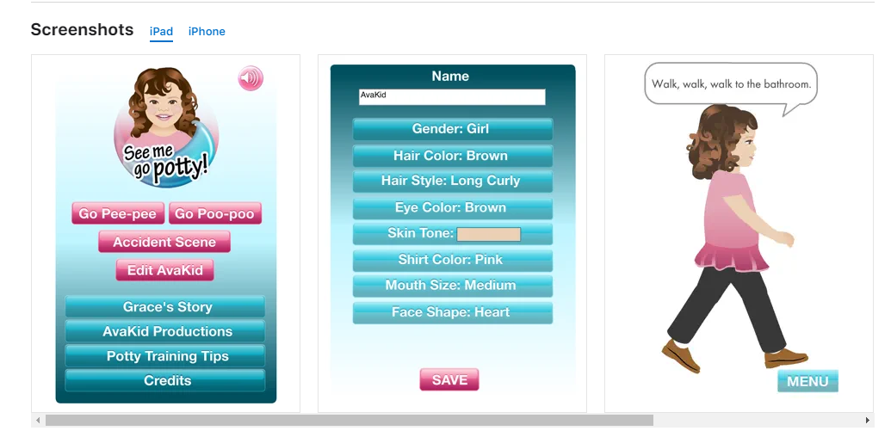
Resources (get on google!)
Conquering wees and poos
See me go potty app
One step at a time
Wiggles toilet song
Bluey toilet song
Daniel Tiger toilet episode
Elmo toilet app
Poo goes to Pooland app

Slide 55
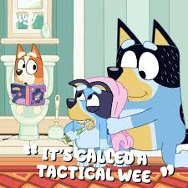
Resources
Resources (get on google!)
Continence Foundation of Australia
  http://www.continence.org.au/
ERIC – the children’s bladder and bowel charity
  https://www.eric.org.uk/
International Children’s Continence Society
  http://i-c-c-s.org/parents/

Slide 56

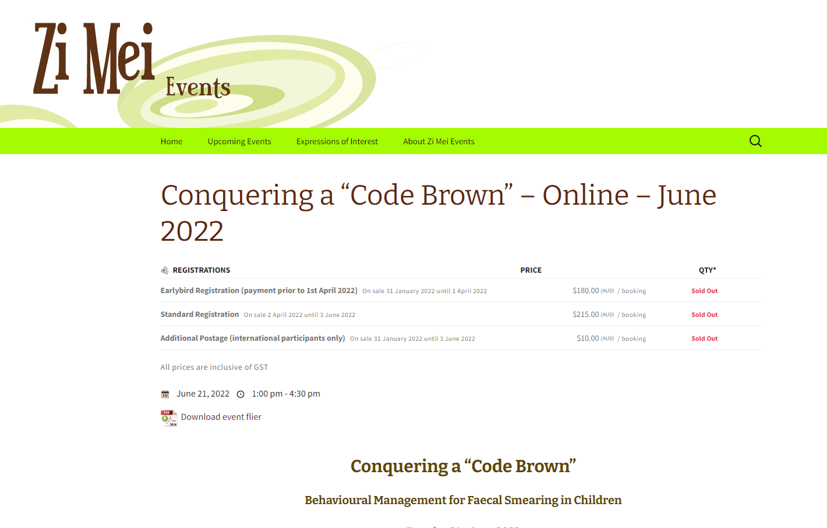
The fun stuff

Slide 57
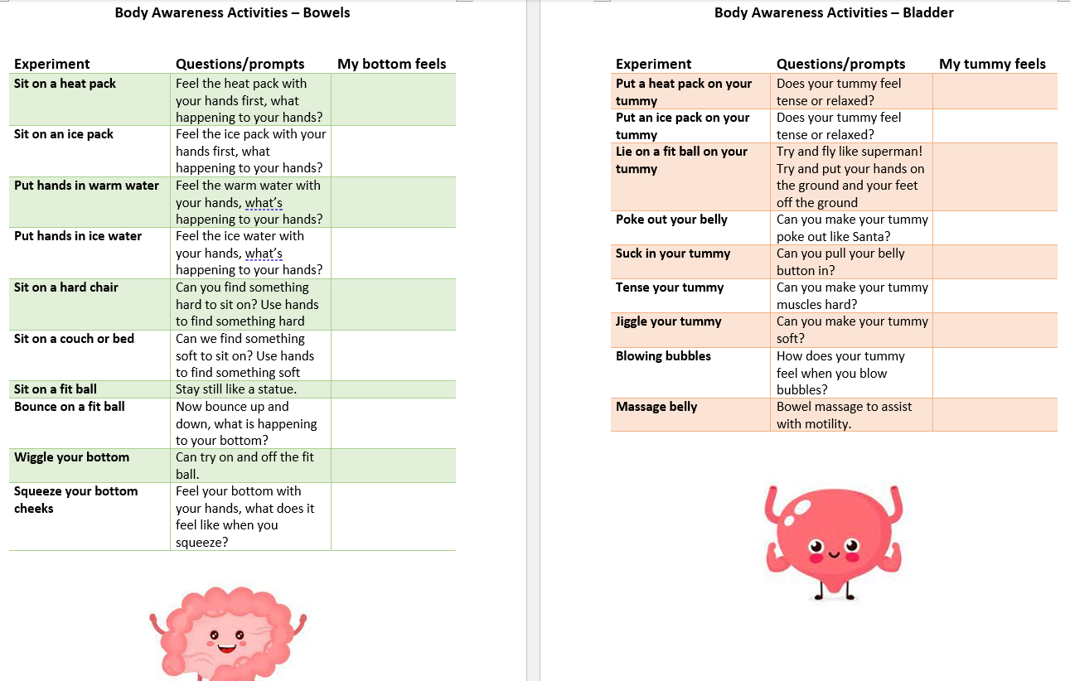
Interoception

Slide 58
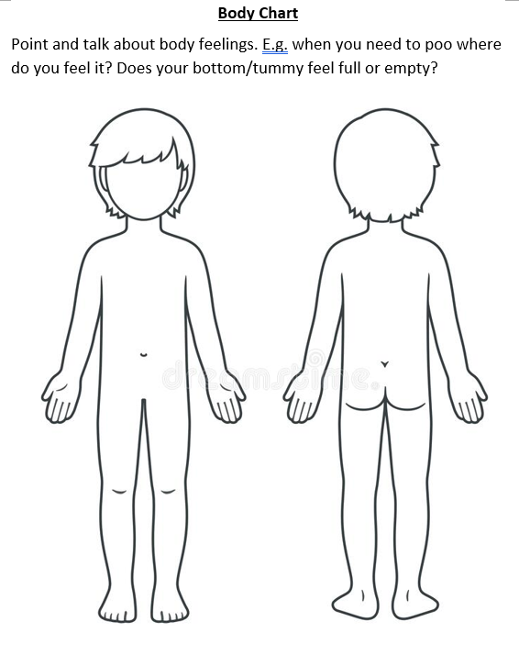
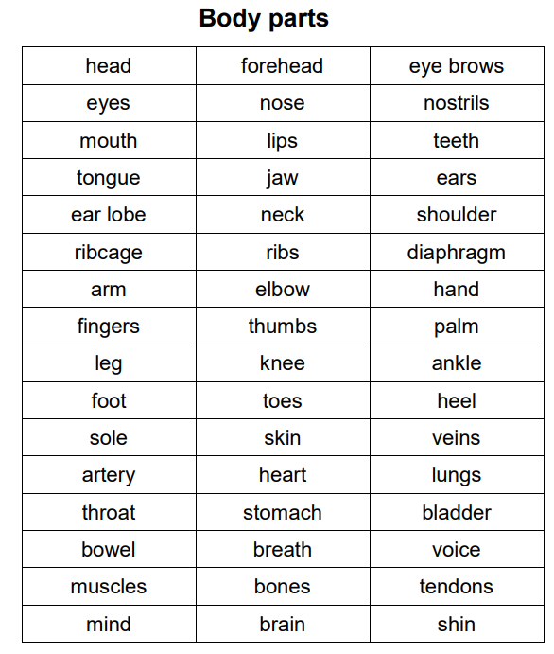
Interoception
Enjoyable activity
Noticing
Draw on body
Descriptor list
Accept all answers
Practice at home
Model!
Notes:
Case study

Slide 59
Toilet training v continence
Whose goal is it?
What is the unintended consequence (reward)?
How long have you been working on this?
What is the harm?
Is this the most pressing issue right now?
What time of year is it?
WWTD?
Notes:
Case study

Slide 60

Notes:
Who has an NDIS plan?

Slide 61
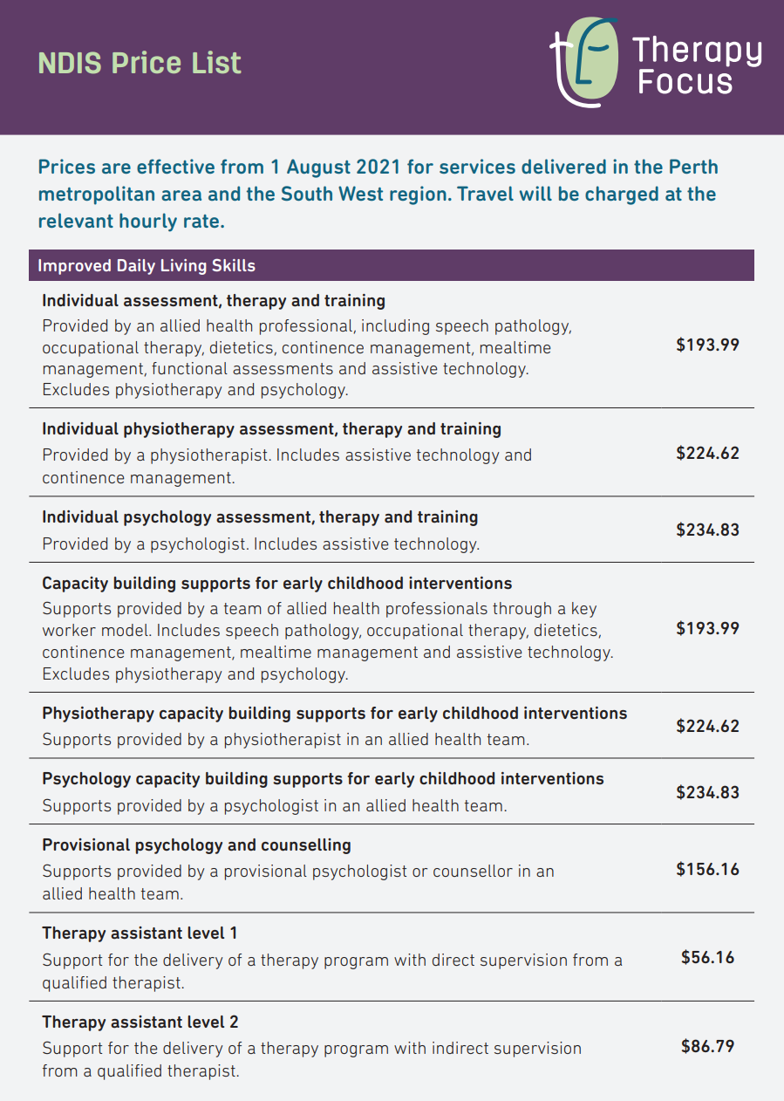
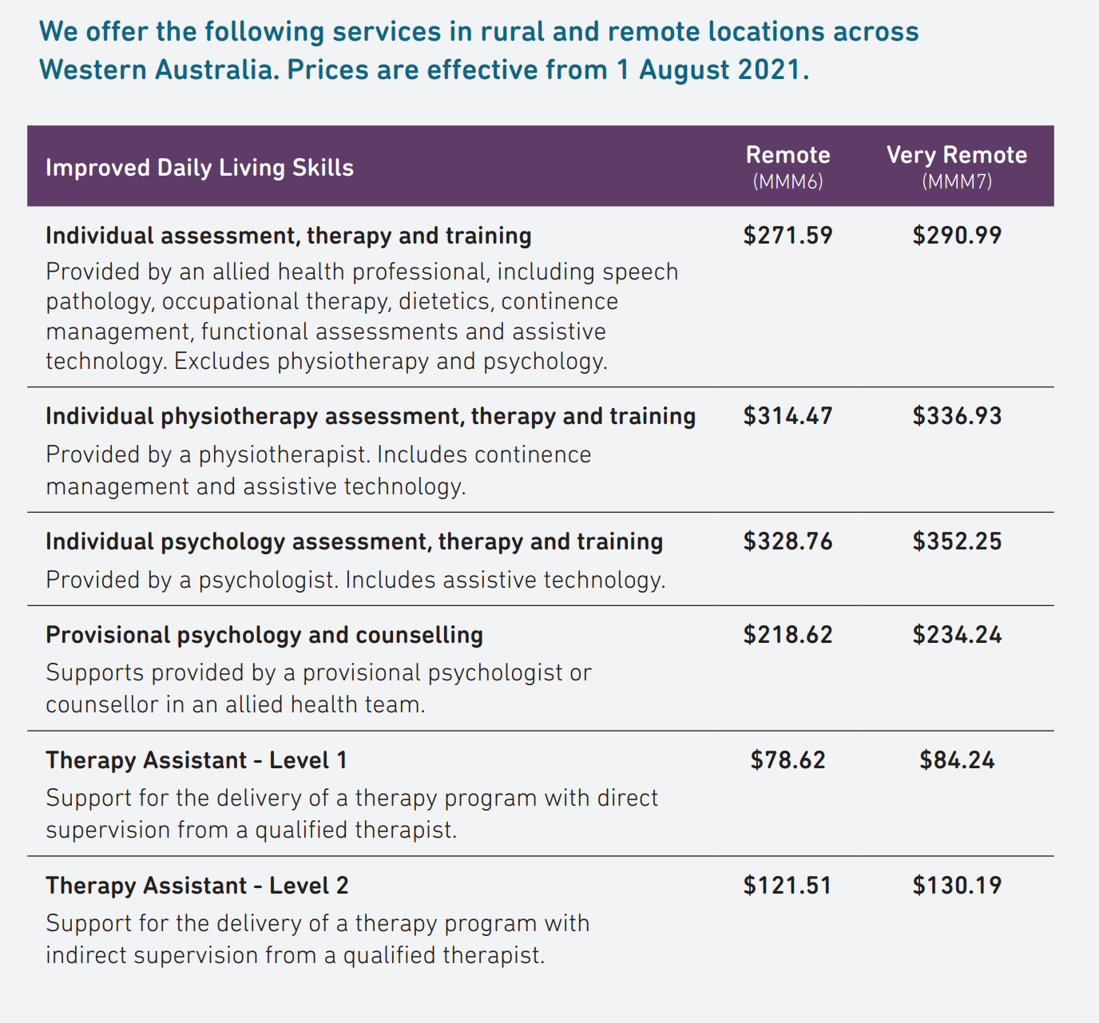
NDIS
0-65
Improved daily living budget
Minimum 12 hours preferred
Notes:
Travelling to Merredin and Albany
12 hours –
Initial 1.5 plus follow up email/notes
Clinic 1r plus notes
GP letter 30
Product ordering
Individual toileting plan 30
Reporting 1hr
School visit – 1.5 (travel)
Home 2 (travel)
Consult with clinician 1hr (30 minutes each)
Follow up clinic/teletherapy – 30-60 each
If a client comes with 3 hours – initial assessment, report only.
If they come with 5 hours, initial assessment, clinic and report only.

Slide 62
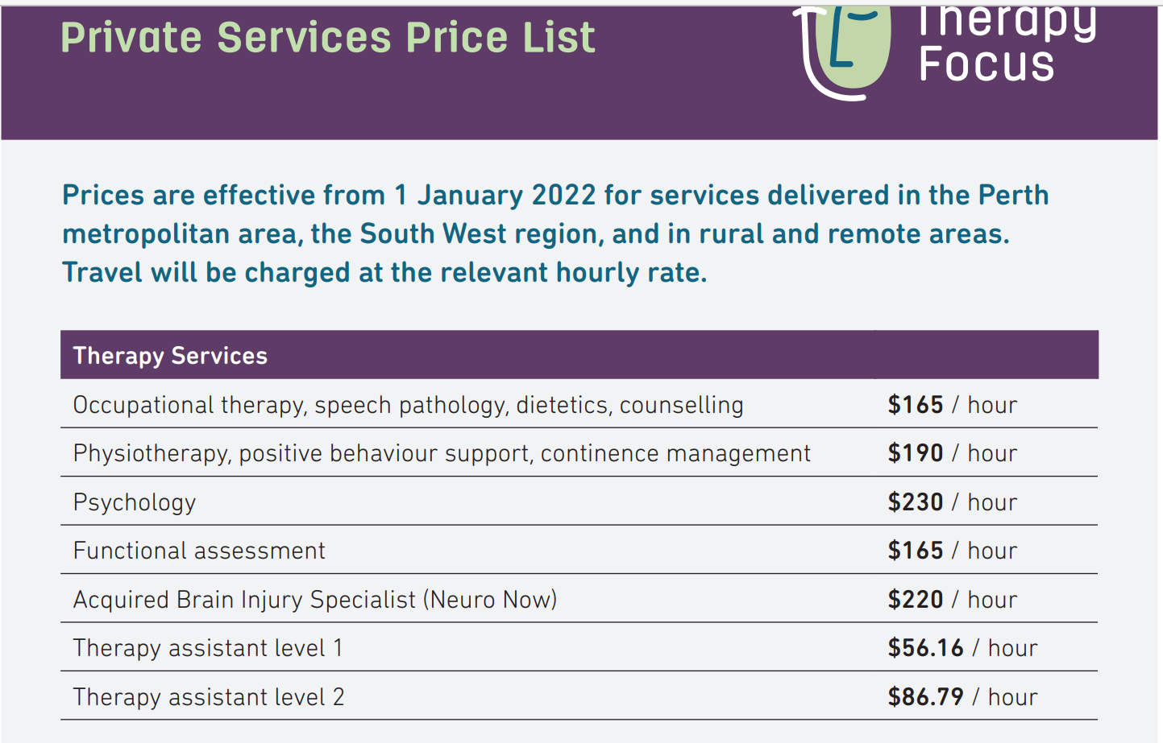
Funding options
Medicare – referral from GP and attend a clinic with an OT or PT
Fee for service
Notes:
NDIS – cannot draw from core support

Slide 63
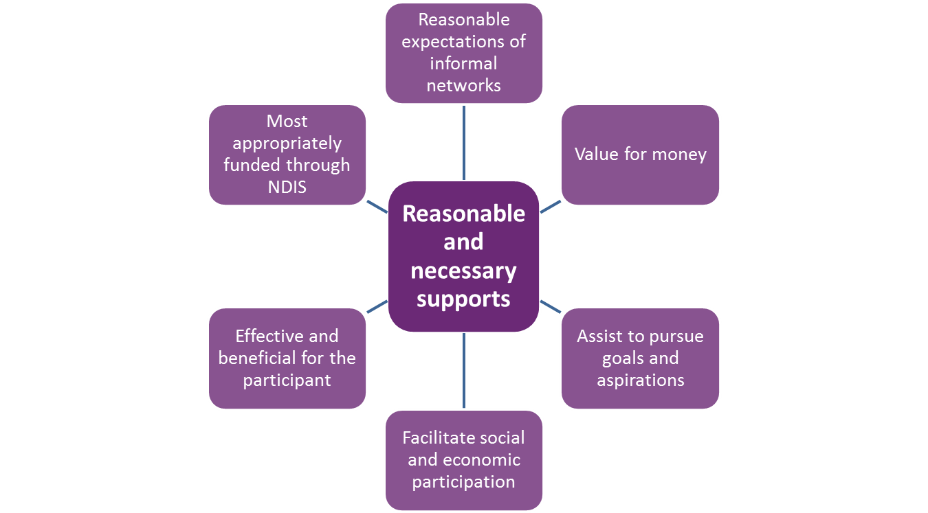
NDIS fund supports that enable participants to…
Make decisions that will affect their lives, to the extent of their ability
Achieve their goals, objectives and aspirations
Maximise their independence
Increase their social and economic participation
Develop their capacity to actively take part in the community
(National Disability Insurance Scheme Act 2013)

Slide 64
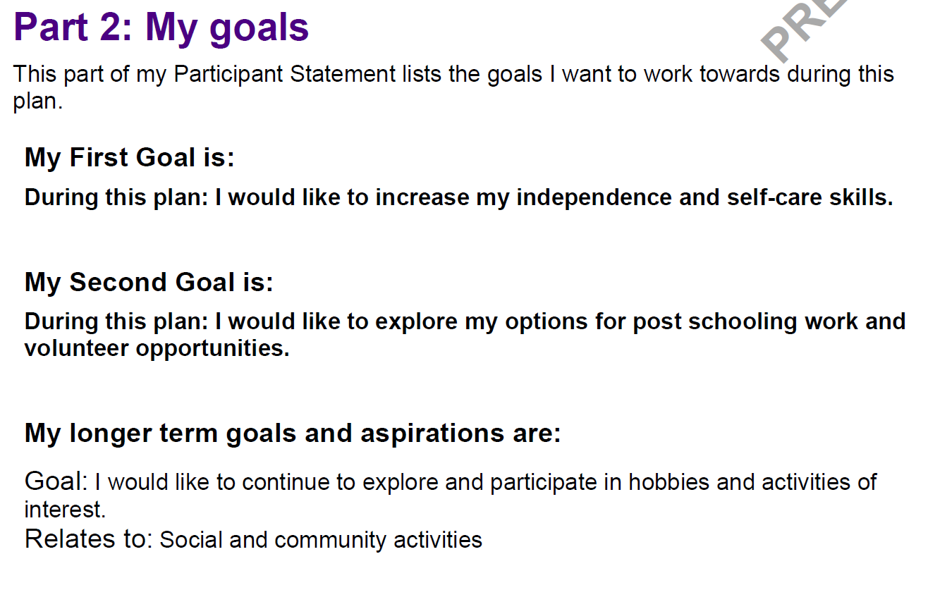
NDIS Participant Goals

Slide 65
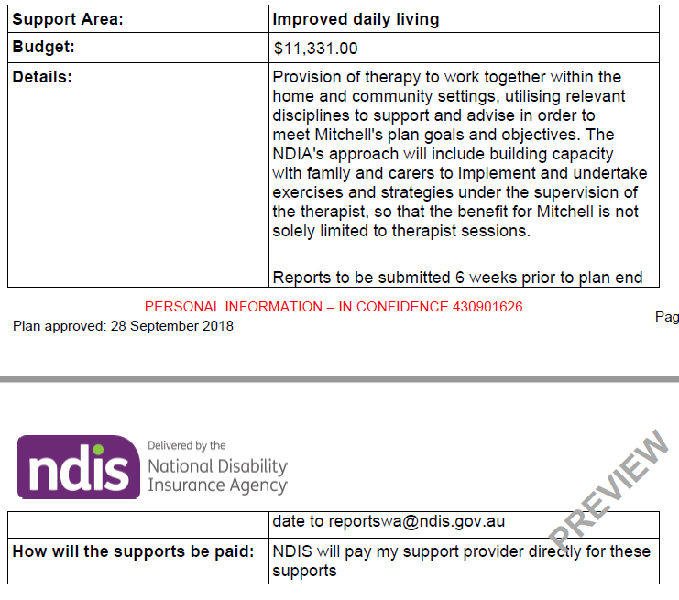
Part 3: My supports

Slide 66
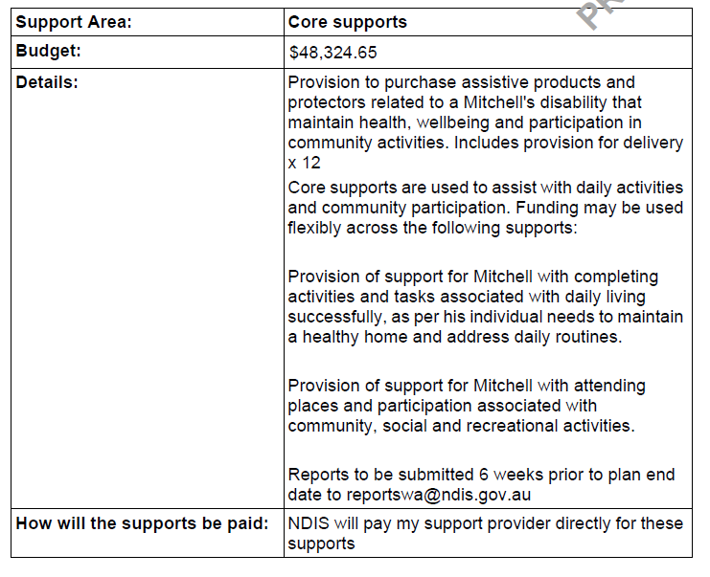

Slide 67
Notes:
PART 3: MY SUPPORTS
- Outlines family and friends, informal supports, services and community groups, community and mainstream
Support Coordination:
TF is listed to deliver this support and we have some Family Connect Workers and clinicians who are delivering on this line item (depending on which level of support this is included as in the plan).
A Support Coordinator helps them to put a plan into action. It’s important that the Plan Co-ordinator builds a participants capacity and works alongside them to help them learn to monitor spending and monitor quality of services.
3 levels of support: Support Connection, Support Co-ordination and Specialist Support Co-ordination. We are only delivering on the last two levels. All requests for involvement with this support need to come through a TL / Project Manager
The request for co-ordination will come from the Planner but as a result of a conversation with the participant and the planner.
The intent is always about capacity building and moving onto the next level of support until it is no longer needed.
Other external organisations:
Sharing with other orgs:
TD packages can be shared with other organisations, however an agreed on amount needs to be worked out with the families prior to service agreements being completed
Important for therapists to be clear if families are wanting us to deliver on supports they have not previously received from us ie psych
Specialist TF services to be discussed later.

Slide 68
NDIS Reporting
6-12 weeks prior to plan end date
Therapy recommendations (continence and other therapies)
Product recommendations
Assistive technology

Slide 69
Let’s review our objectives
Notes:
Bowel and bladder function of children
When to be concerned/red flags
Overview of Therapy Focus’ continence service
Toilet training best practice
NDIS preparation
Questions

Slide 70
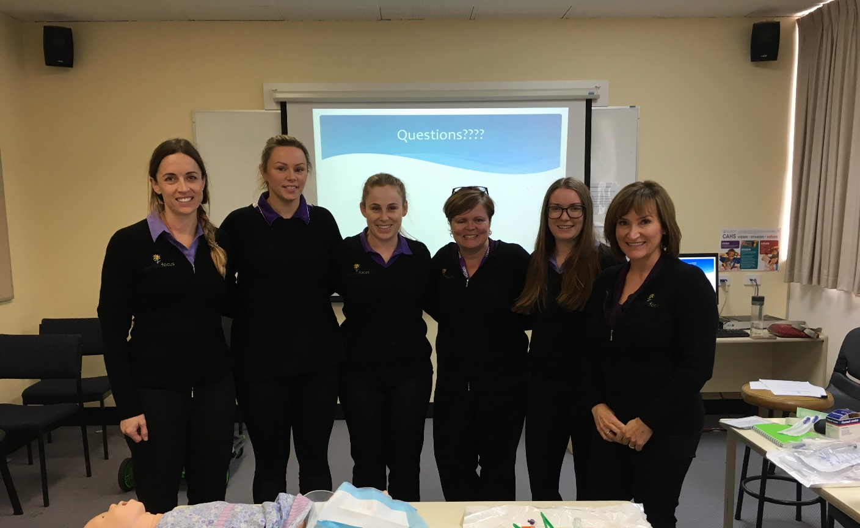
Questions?

